Slide 1
Python Explained

Slide 2
Content
Zero Indexing
Different Types of Errors
Different Types of Equals

Slide 3
Why does python use zero indexing
In python when we are referring to the index of an item in a list or string we are talking about its position
Zero indexing means that the first item in the sequence is at position 0, the second item is at position 1, the third item is at position 2, and so on

Slide 4
Zero Indexing Example – Floor analogy
Imagine you're in a building with multiple floors. Each floor has its own number, just like each item in a list has its own index. Here's how we can relate building floors to zero indexing:
Ground Floor (0th Floor):
The ground floor of the building is like the 0th floor in Python's zero indexing.
It's the starting point, the base level.
In Python, the first item in a list is at index 0, just like how the ground floor is the starting point in a building.
First Floor (1st Floor):
In a building, the floor above the ground floor is the 1st floor.
Similarly, in Python, the item at index 1 is considered the "first" item in the list.
Second Floor (2nd Floor), Third Floor (3rd Floor), and so on:
Continuing the analogy, each subsequent floor in the building is numbered incrementally.
Likewise, in Python, each item in a list is indexed incrementally. The item at index 2 is the "second" item, the item at index 3 is the "third" item, and so on.

Slide 5
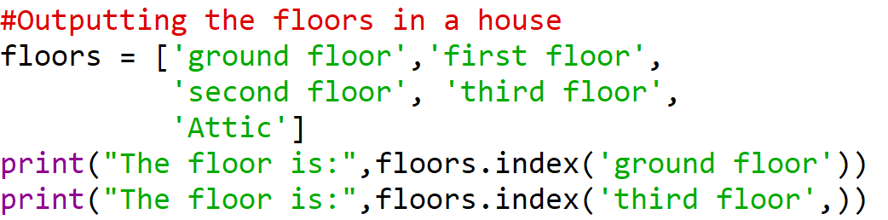

Zero Indexing Example – Floor analogy

Slide 6
Most Common types of Errors
Syntax Errors
Indentation Errors
Name Errors
Type Errors
Index Errors
Value Errors
Key Errors
Attribute Errors
File Errors
Import Errors

Slide 7
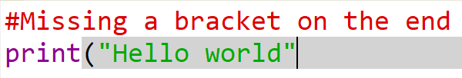
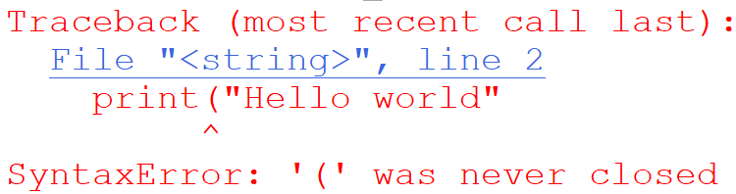
Syntax Errors
Syntax errors occur when Python encounters code that does not follow the conventions of the Python language
These errors prevent code from running at all

Slide 8
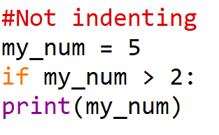
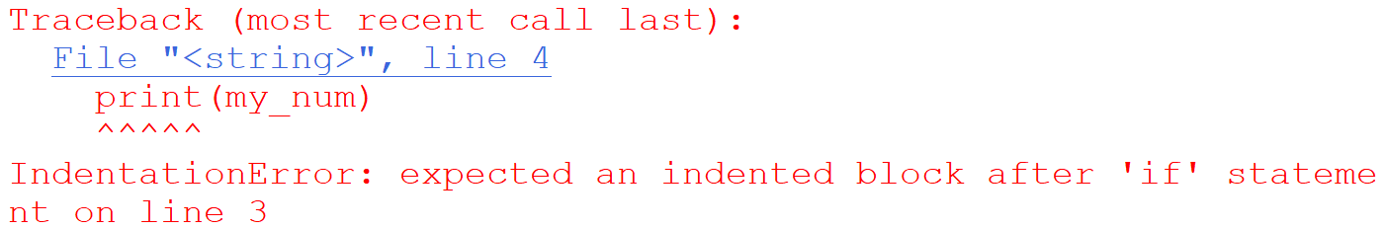
Indentation Errors
Python uses indentation to determine the structure of the code
Inconsistent or incorrect indentation can lead to errors

Slide 9

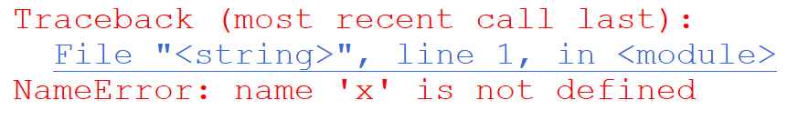
Name Errors
Occurs when you try to use a variable or function that hasn’t been defined yet or is out of scope

Slide 10

Type Errors
Occurs when you try to perform an operation on objects of incompatible types

Slide 11

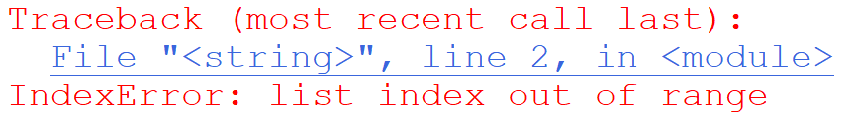
Index Errors
Occurs when you try to access an index in a sequence that doesn’t exist

Slide 12

Value Errors
Occurs when a function receives and argument of the correct type but an inappropriate value

Slide 13

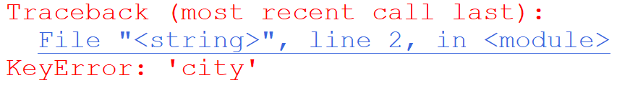
Key Errors
Occurs when you try to access a dictionary key that doesn’t exist

Slide 14

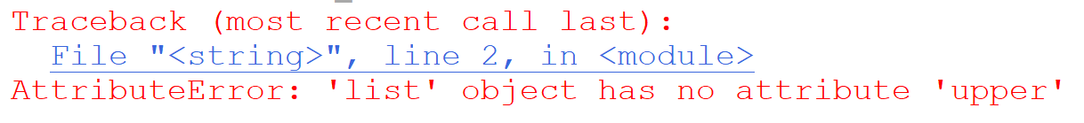
Attribute Errors
Occurs when you try to access an attribute or method of an object that does not exist

Slide 15
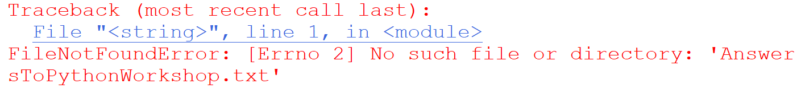
File Errors
Occurs when there’s an issue with file operations
Such as trying to open a file that does not exist

Slide 16

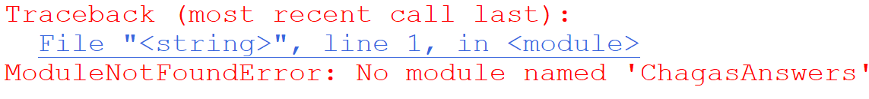
Import Errors
Occurs when Python cannot find the module or library you’re trying to import
Or if there’s an issue with the module or library itself

Slide 17
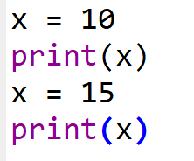

Different types of equals - Assignment
The assignment operators (=) is used to assign a value to a variable

Slide 18
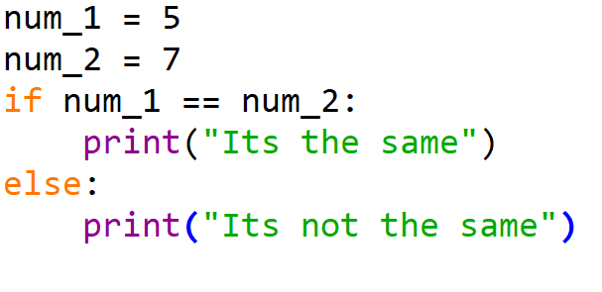

Different types of equals - Equality Comparison
The equality operator (==) is used to compare whether two values are equal

Slide 19
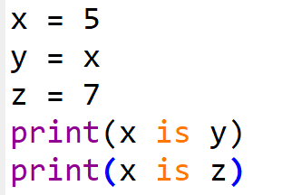

Different types of equals – Identity Comparison
The identity operator (is) is used to compare whether two variables refer to the same object in memory

